Slide 1

BRIGHTLIGHT COFFEE SHOP
SALES ANALYSIS

Slide 2
INTRODUCTION
The aim of this project is to analyze coffee sales across our three stores using excel raw transaction data, to uncover patterns, track store performance and provide data driven recommendations to improve revenue and efficiency

Slide 3
PROBLEM STATEMENT
The store has just hired a new CEO, whose focus is on revenue, product improvement and growth, this analysis aims to uncover and unpack key insights from sales data to guide for better decision making

Slide 4
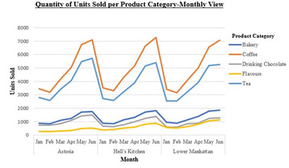

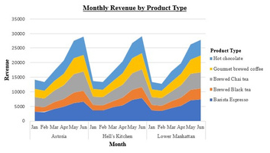
Months and seasons have different impact in our coffee shop industry, this is visible on the above graph. January and February (summer season) the units sold dipped while we see June having the highest units sold across all our stores.
In all the product types that our stores are making revenue on, these are the top 5, most sold, top contributing product types with Gourmet Brewed Coffee alone in the coffee category bringing home more than 25 000 in June.

Slide 5
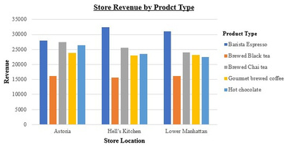
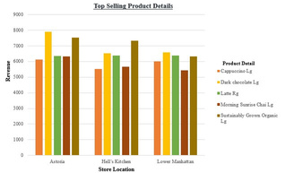
We see Barista Expresso being the most preforming product type across all our stores with the highest revenue coming from Hell’s Kitchen, followed by Lower Manhattan, while Astoria has most sales of Brewed Chai Tea, slightly above 25 000 of Hell’s Kitchen. This graph depicts top 5 of our best performing product types.
The above graph shows the top selling product details per store, with dark chocolate in our Astoria store leading and cappuccino Lg doing relatively well in all our stores.

Slide 6
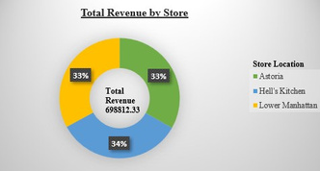
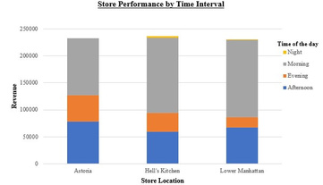
All our stores are performing at similar levels, with Hell’s Kitchen slightly in the lead with very small margin. It’s safe to say we are doing well as we have a total revenue of 698,812.33 across all our stores.
Mornings show to be the strongest and busiest time of the day as most of our revenue is made during this period, followed by Afternoons. We also notice that Astoria has sales that are slightly higher compared to the other stores in the Afternoons.

Slide 7
RECOMMENDATIONS
Hell’s Kitchen: has high revenue, we should try and adopt its strategy and make sure that our customer service remains excellent also monitor customer feedback to keep the store’s revenue growing.
Morning: Is showing to be the most profitable time of the day across our stores, we could look at increasing our personnels and stock accordingly.
Barista Espresso: Is our top selling product, we must make sure that we have enough stock and ensure marketing support so that its sales continue to increase.
Astoria: Pride itself by brewed chai tea and dark chocolate, we could explore customer preference and see if we can make promotions on other products to increase their sales.
Seasonality: Seasons like summer affect our sales as we have seen on our graph that Jan and Febr sales are very low, we could build marketing strategies to avoid these dips in our sales.

